Slide 1




A Big Thank You!
Future Data Driven
We would like to express our deepest gratitude for submitting your session proposal.
Notes:
Content: We would like to express our deepest gratitude to all the speakers who shared their valuable insights and experiences at the Future Data Driven Summit.

Slide 2
A Big Thank You!
Future Data Driven
We would like to express our deepest gratitude to you as a speaker who shared their valuable insights and experiences at the Future Data Driven Summit.
Notes:
Content: We would like to express our deepest gratitude to all the speakers who shared their valuable insights and experiences at the Future Data Driven Summit.

Slide 3

A Big Thank You!
Future Data Driven
Volunteers
You did a fantastic job as a volunteer and made this event possible. You were brilliant and we appreciate your service and support immensely.
Notes:
Content: We would like to express our deepest gratitude to all the speakers who shared their valuable insights and experiences at the Future Data Driven Summit.

Slide 4

A Big Thank You!
Future Data Driven
You have done a marvelous job as event organizer. We appreciate your dedication and skill.
Notes:
Content: We would like to express our deepest gratitude to all the speakers who shared their valuable insights and experiences at the Future Data Driven Summit.

Slide 5

SPECIAL THANKS
We are grateful to our speakers, volunteers, sponsors and organizers for making this event a success.

Slide 6
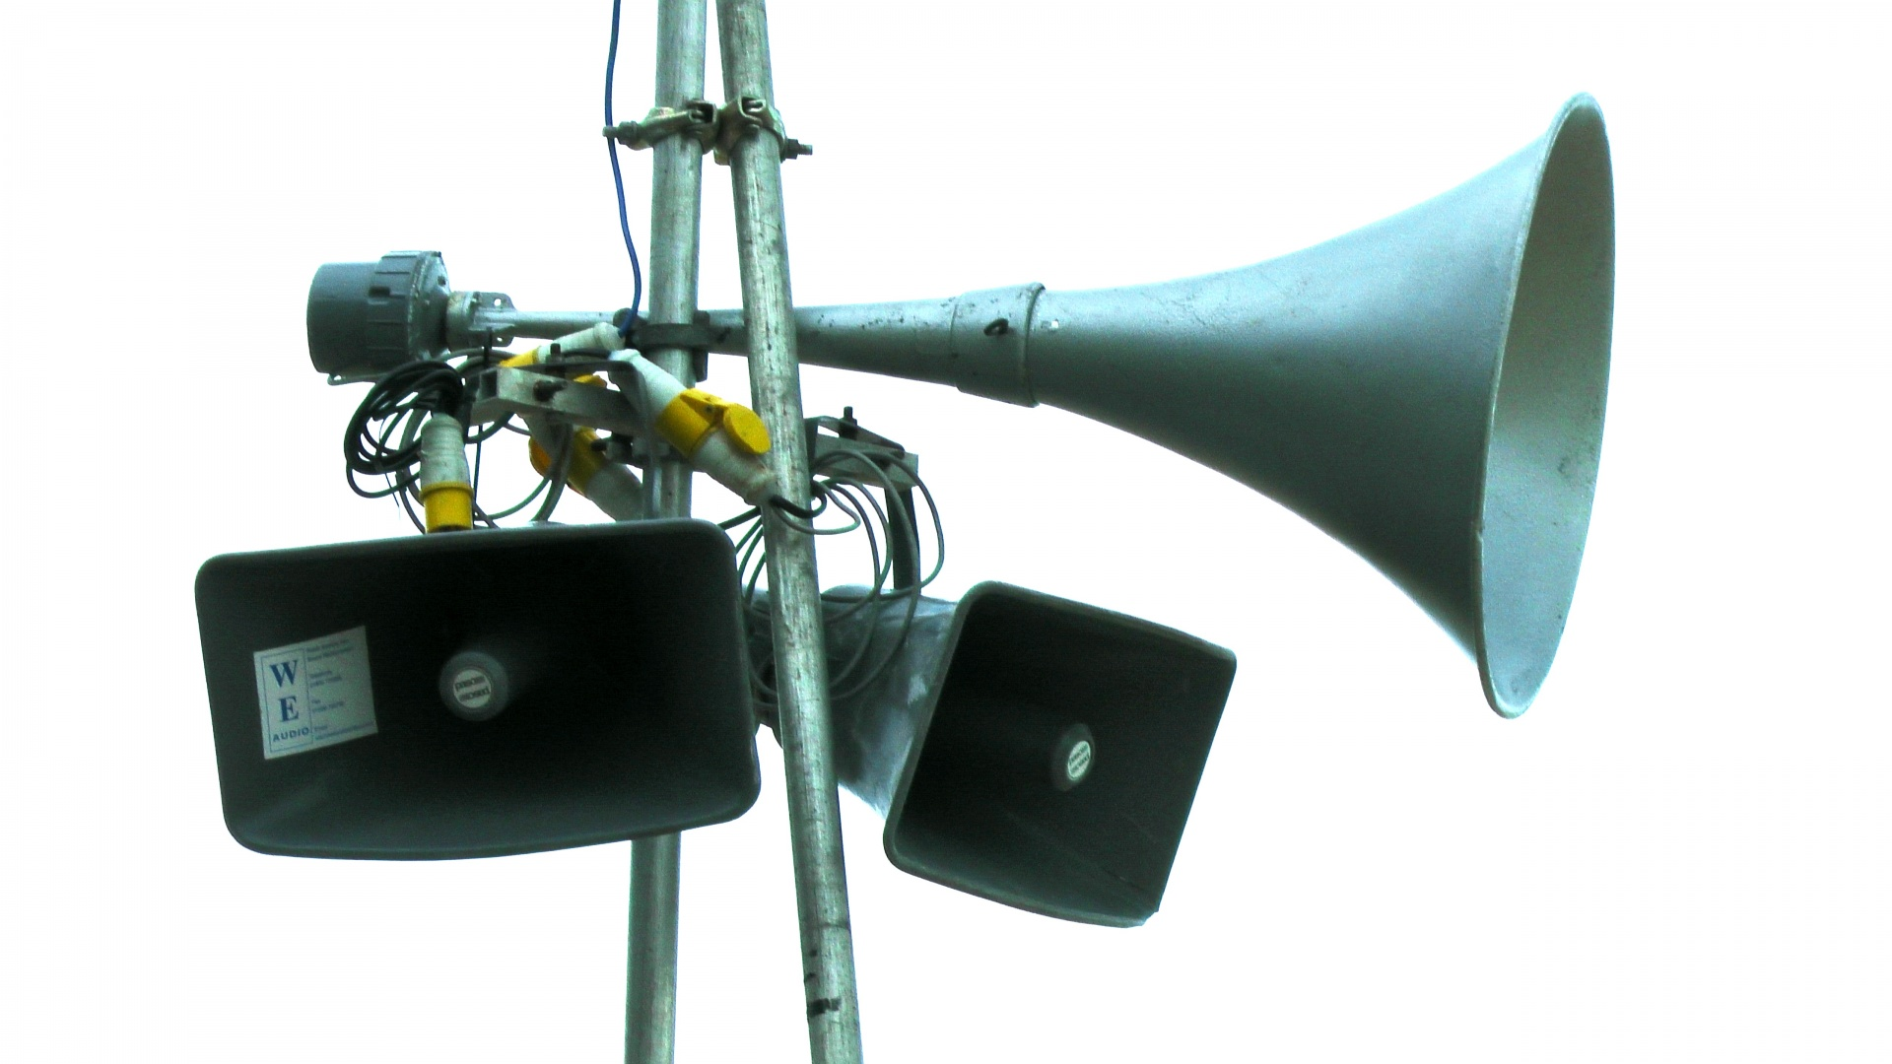



A Big Thank You!
Future Data Driven
We would like to express our deepest gratitude to all the speakers who shared their valuable insights and experiences at the Future Data Driven Summit.

